Slide 1

A project on Password Based Door Locking System
Presented By |  | Supervised By
Mafuja Akter Mitu (18192103068) |  | Md. Anwar Hussen Wadud Assistant Professor
S M Masfequier Rahman Swapno (18192103087) |  | Dept. Of CSE (BUBT)
Asraful Islam (18192103070)
Rahnuma Nurain Sujana (18192103049)

Slide 2
Outline of this presentation
OBJECTIVE
INTRODUCTION
COMPONENTS USED
SOFTWARE DESCRIPTION
ADVANTAGES
FINAL PROJECT
FUTURE SCOPE
CONCLUTION

Slide 3

1. OBJECTIVE

Slide 4
OBJECTIVE
Increase the security level to prevent an unauthorized unlocking of the door.
Give the flexibility to the user to change or reset the password in case the user forgets that combination.
Lock the door by using password.
To give user more secure yet cost-efficient way of door locking system.

Slide 5

introduction

Slide 6
Introduction
Since the main intension of this project is to design a security Door locks system. In order to fulfill this application there are few steps that has been performed.
Designing the power supply for the entire circuitry
Selection of microcontroller that suits our application
Selection keypad
Selection of micro servo

Slide 7
introduction
Selection of LED
Selection of LCD according to the requirement
Complete studies of all the above points are useful to develop the project.

Slide 8
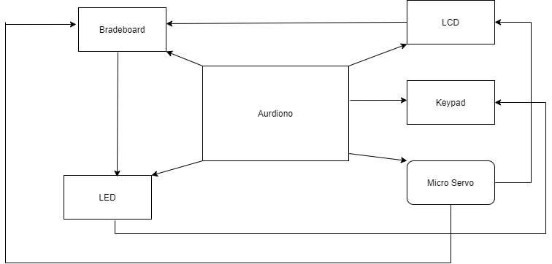
Block diagram

Slide 9
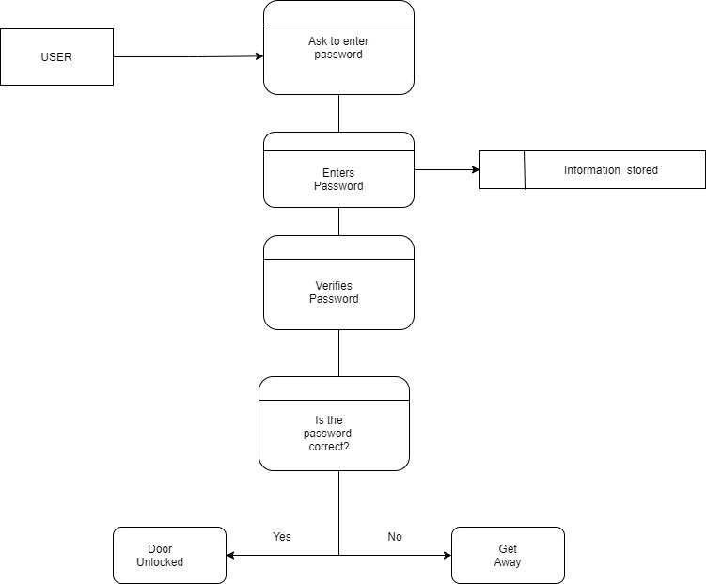
Data flow diagram(dfd)

Slide 10

Component used

Slide 11
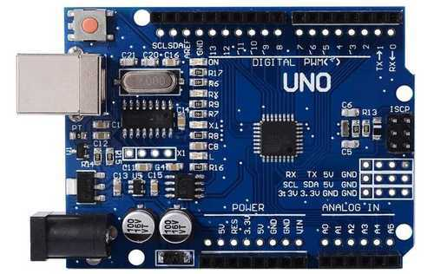
Arduino-uno
The Arduino Uno is an open-source microcontroller board based on the Microchip ATmega328P microcontroller.

Slide 12
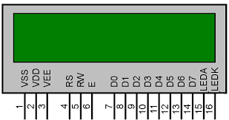
Lcd(16x2)
These are the final indicating devices for displaying the information.

Slide 13

led
A light-emitting diode (LED) is a semiconductor device that emits light when an electric current is passed through it.

Slide 14
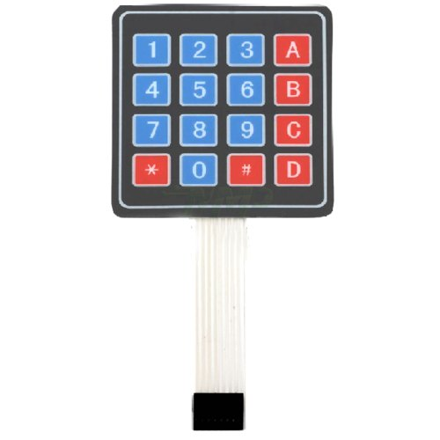
Keypad(4x4)
It is an input device that helps enter a code to open the door .This block gives the entered code signals to the microcontroller.

Slide 15
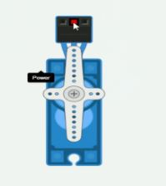
Micro servo
A servomotor is a rotary actuator or linear actuator that allows for precise control of angularor linear position, velocity and acceleration.

Slide 16

Software description

Slide 17
Software description
software:Tinkercad web based software is used for the simulation of circuit.
Coding Used: Embedded c++ language with the implementation

Slide 18

Advantages

Slide 19
advantages
No keys to be lost, stolen or occupied.
Can be locked using keypad.
Autmatic door opening.
Giives an indication for unauthorized entry.
totally cost efficient

Slide 20

final project

Slide 21
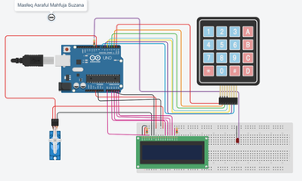
Project

Slide 22

Step-1
The project is simulated

Slide 23
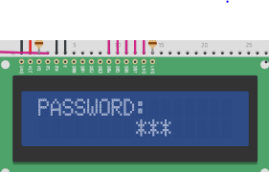

Step-2
Enter the password
When the password is entering the led is lit.

Slide 24
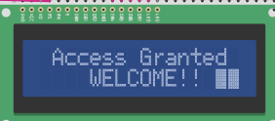
Step-3
Now lock is activated enter the correct password to open the door,with the display
“Access Granted Welcome!!”.

Slide 25
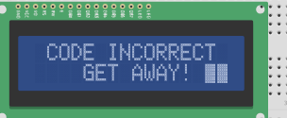
Step-4
In case wrong password is entered to not open the door with the display “ GET AWAY!”

Slide 26

Future scope

Slide 27
Future scope
We can send this data to a remote location using mobile or internet.
We can add fingerprint sensor so entry will be allowed for the authorized person using their fingerprints.
We can add fire, wind and LPG sensors so that in case of accident, the doors will automatically open

Slide 28

Conclusion

Slide 29
Conclusion
Password Based Door Locking Security System is used in the places where we need more security. It can also be used to secure lockers and other protective doors. The system comprises a number keypad and the keypads are connected to Arduino uno microcontroller. The microcontroller continuously monitors the keypad and if somebody enters the password it will check the entered password with the password it will check the entered password with the password stored .If entered password is correct then us.

Slide 30


